Slide 1
Introduction
20L-0935 – AbdulRahman Nadeem
20L-1122 – Hassan Jawwad
20L-1149 – Yousaf Khalid
20L-2177 – Talha Zulifqar
Image Classification
On
Human Face – Emotion/Sentiment Analysis

Slide 2
Detect facial expression on Human Face & Classify it accordingly
Classification Classes:
Happy
Neutral
Surprised

Slide 3
Solution
Using popular AI object classification models.
Trained on custom data. Because data was hard to find.
Training data should consist of different quality.
Training data should be large enough.
Training data should be of different faces.

Slide 4
Methodology
We used Yolov5 – Yolov5s model. - https://github.com/ultralytics/yolov5
CNN
We captured our own custom data.
470 images for training
90 images for testing
Labelling – on basis of classes.
Using python label-studio
Training using 100 epochs.
Batch size 16
Image dimensions 1024
Open CV
For data collection
For demo

Slide 5
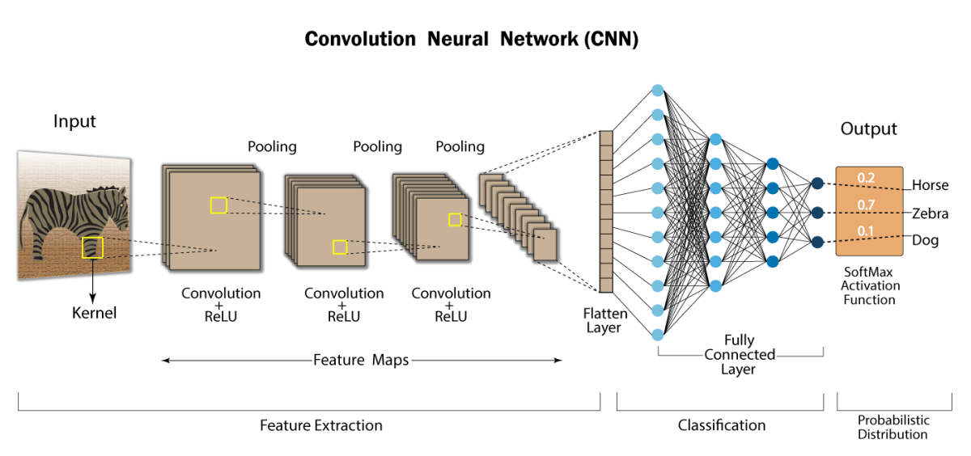
https://developersbreach.com/convolution-neural-network-deep-learning/

Slide 6
Demo

Slide 7
OUR DATA

Slide 8
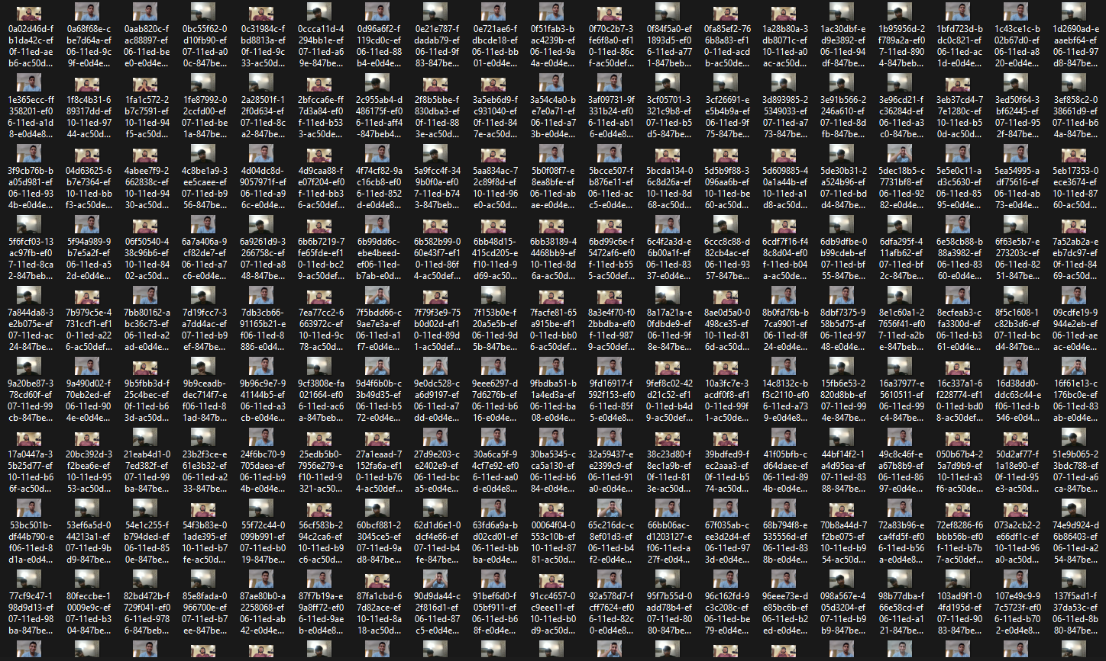

Slide 9
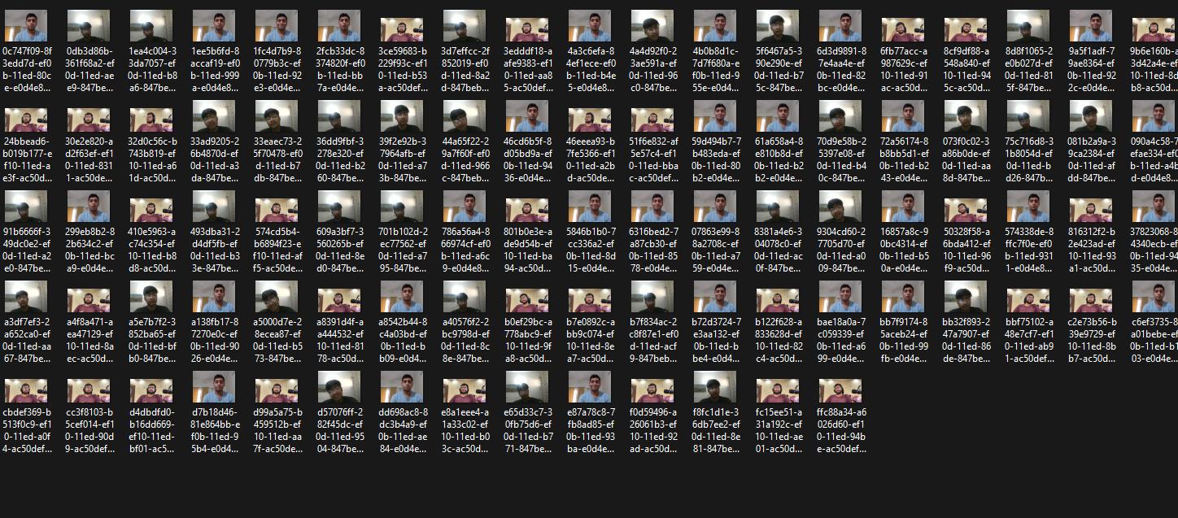

Slide 10
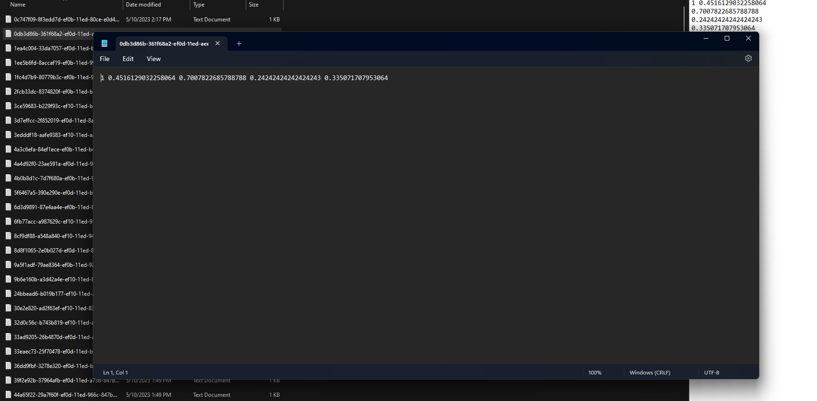

Slide 11
Data_Collection .py

Slide 12
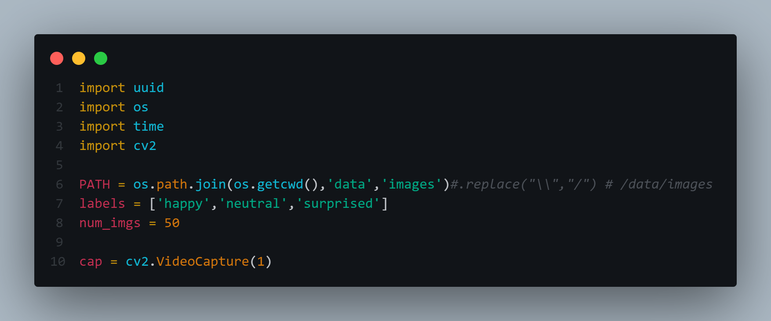

Slide 13
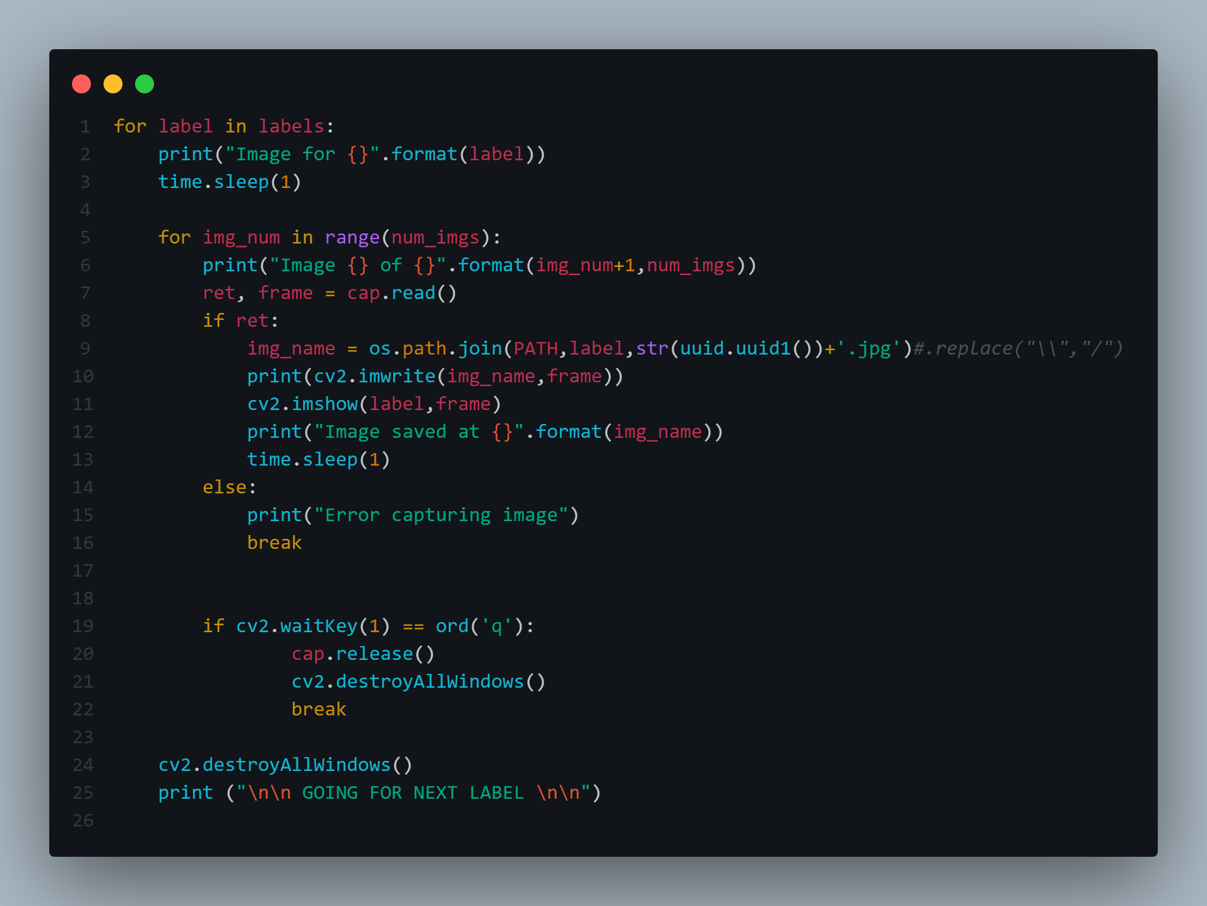

Slide 14
Model Demo

Slide 15
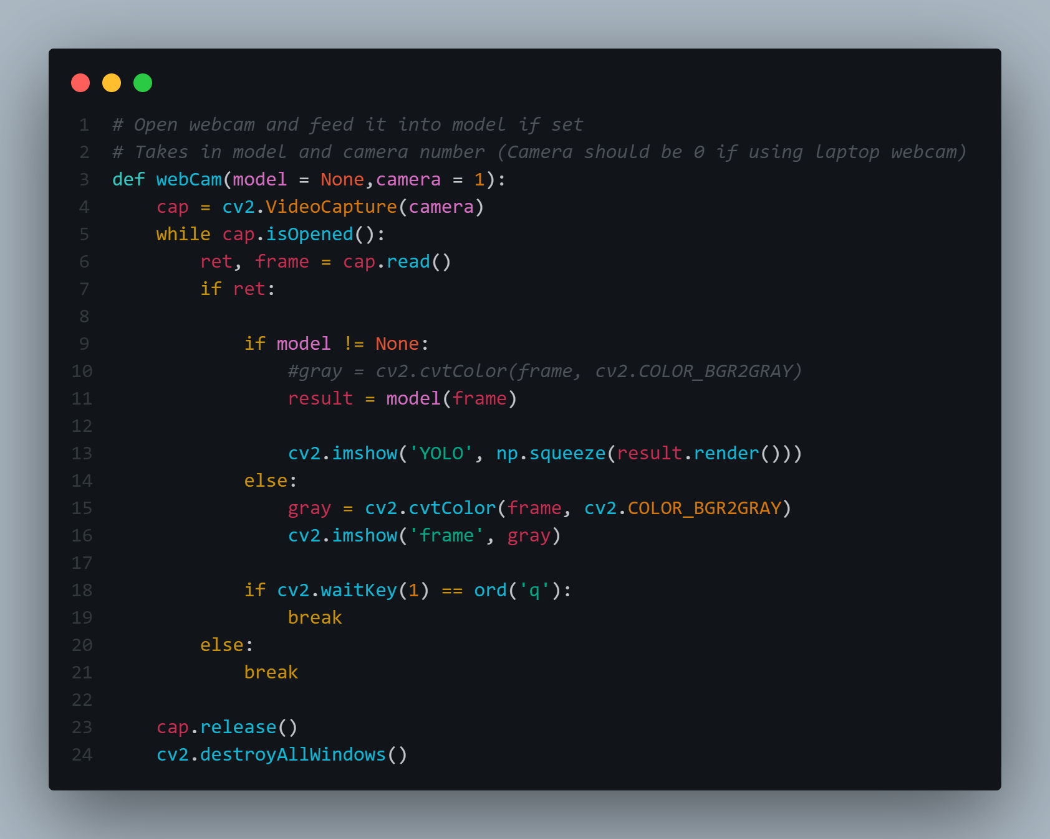

Slide 16
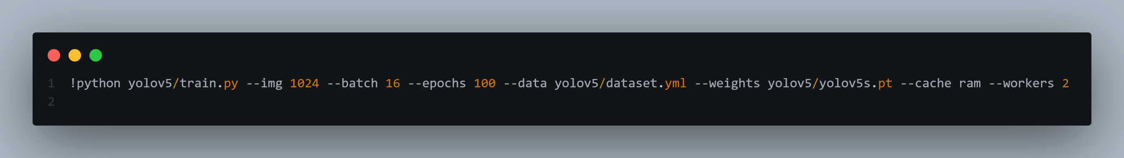

Slide 17
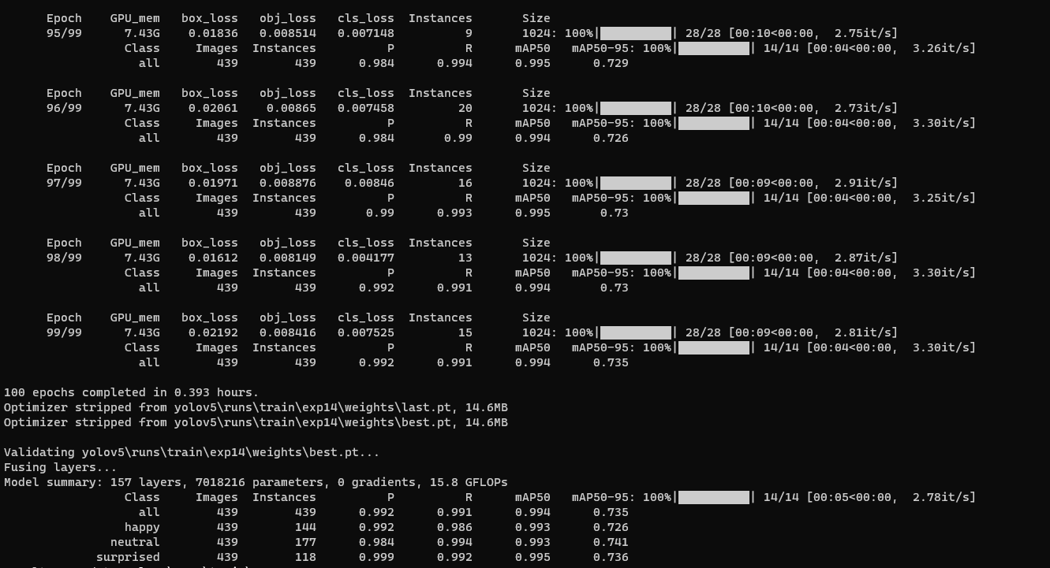

Slide 18
In Action

Slide 19
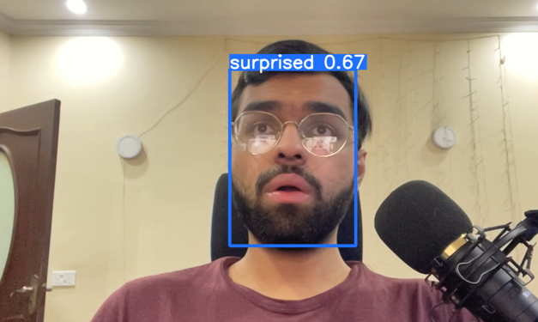
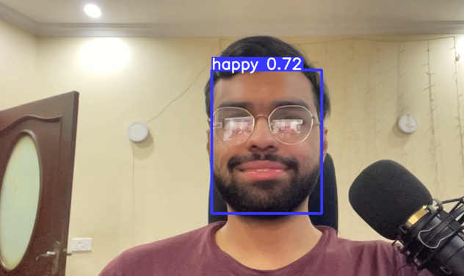
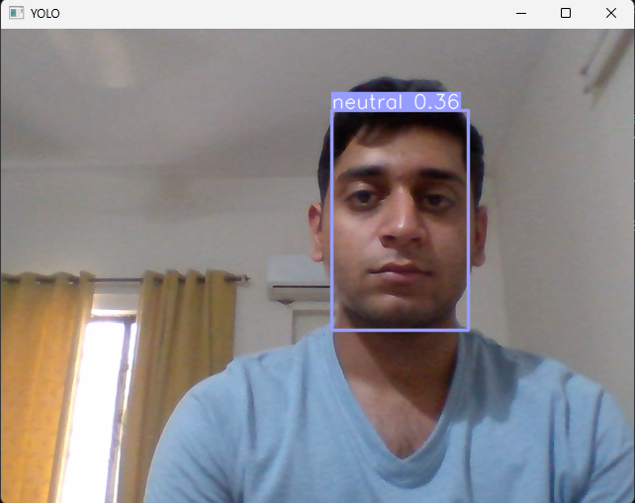

Slide 20
Conclusion

Slide 21
We can make this better
More extensive dataset
More faces
More expression
More random noise
Image editing:
We could change our image to grayscale or increase gamma.
Smaller and better boundary for labeling.
More epochs

